Slide 1
Sequential Pattern Mining on Webpage Hits Data
Presented By
Ningle Lei
Ashwini Kulkarni

Slide 2
Introduction
Expansion of World Wide Web → large amount of data
Discover frequent pattern in web data
Goal: gain information about users’ navigational behavior (We will mainly focus on using data mining approach, such as frequent pattern mining to achieve our goal)

Slide 3
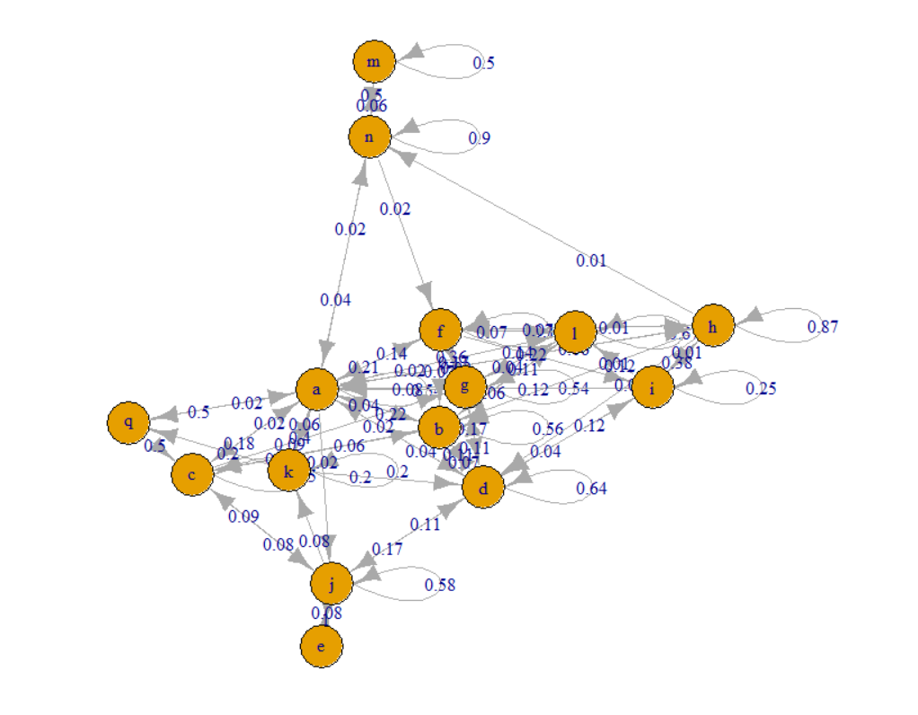
Application Areas
Scientific Research
Target Marketing : advertising purposes, creating dynamic user profile, etc.
Language Processing

Slide 4
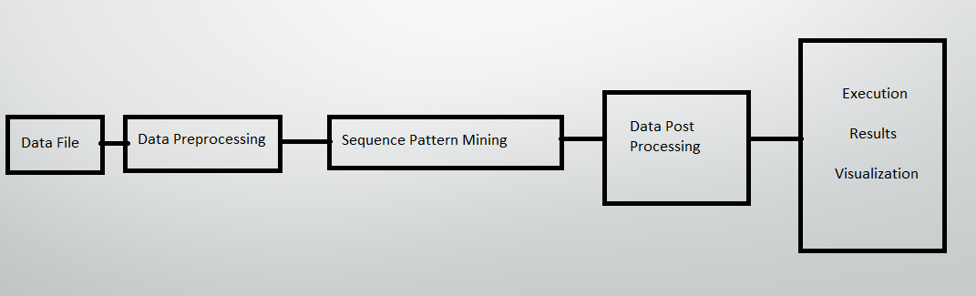
Project Overview
Aim: Recognizing Sequence pattern

Slide 5
Data Description
archive.ics.uci.edu
This data describes the page visits of users who visited msnbc.com on one day. Visits are recorded at the level of URL category (see description) and are recorded in time order.
The categories are "frontpage", "news", "tech", "local", "opinion", "on-air", "misc", "weather", "health", "living", "business", "sports", "summary", "bbs" ,"travel", "msn-news", and "msn-sports".
Data Set Characteristics: | Sequential | Number of Instances: | 989818
Attribute Characteristics: | Categorical | Number of Attributes: | 17

Slide 6
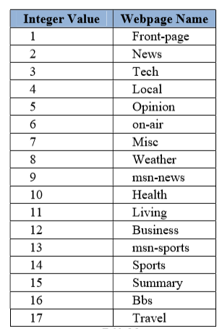
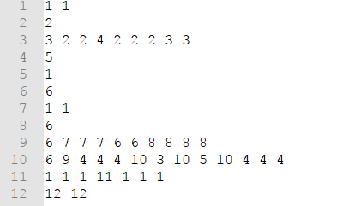
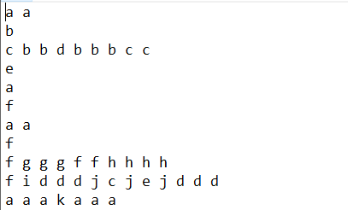
Data Preprocessing
Removing Extra Spaces
Converting digit to alphabets

Slide 7
Sequence Pattern Mining
Minimum Support is: 0.1 of no of records
1........K=1
2........Item set size K with minimum Support
3........Add frequent set in temp array
4........for each itemset t in temp array
prefix= t
add prefix to final
5............... find frequent item after visiting t with minimum support
if not null (now item set size is k =k+1) gotostep 3
else continue

Slide 8
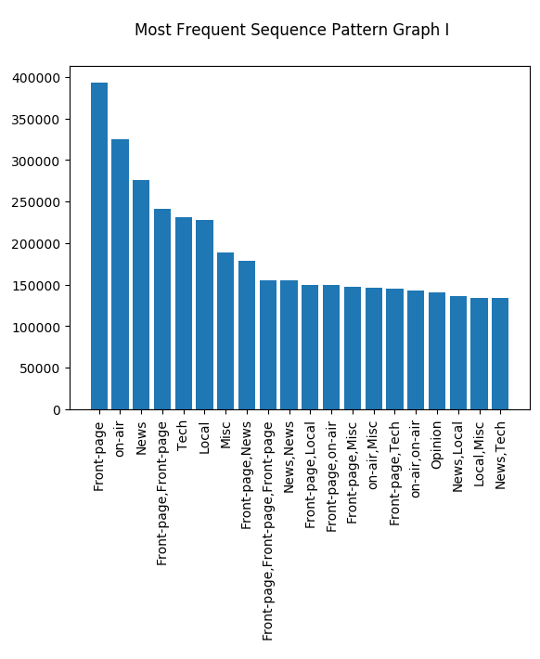
Execution Result I
Most Frequent Sequence Patten
Min Support(98,981.8)

Slide 9
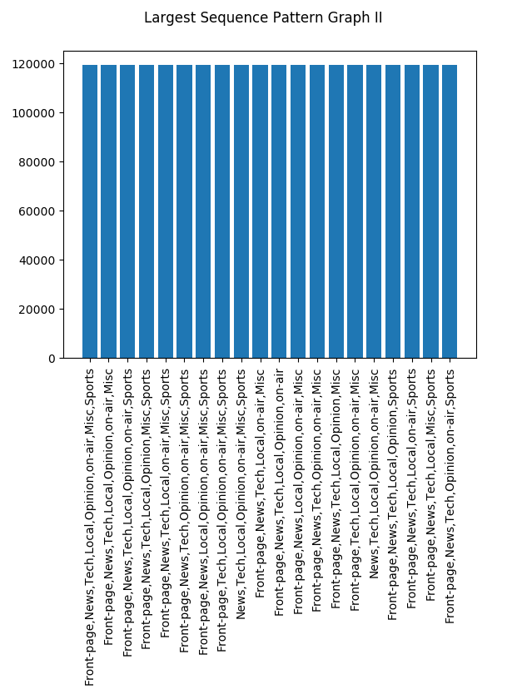
Execution Result II
Largest Frequent Sequence Patten
Min Support(98,981.8)

Slide 10
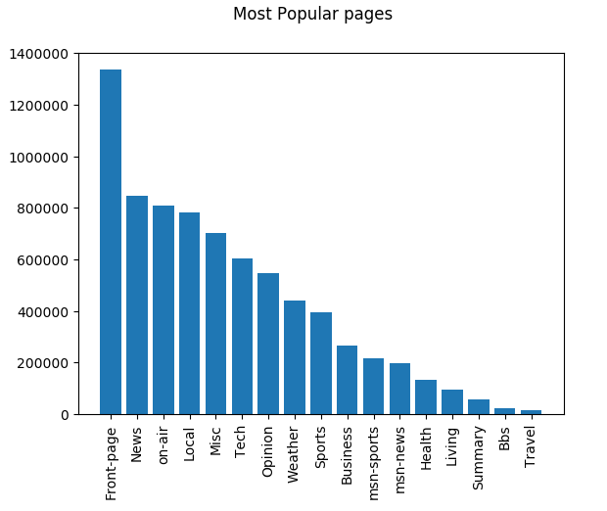
Execution Result I
Most Popular Pages

Slide 11
Future work
Implementing generic model for sequence pattern recognizing
Expand applications for other attributes.
Implementation using Real Time data.
Minimizing large file processing time.

Slide 12
References
http://archive.ics.uci.edu/ml/datasets/MSNBC.com+Anonymous+Web+Data
http://archive.ics.uci.edu/ml/datasets/MSNBC.com+Anonymous+Web+Data
https://docs.python.org/2/library/sets.html
https://docs.python.org/3/tutorial/datastructures.html

Slide 13
Thanks! Q&A

